Slide 1
Challenges Facing Modern Society
Key Issues and Potential Solutions

Slide 2
Introduction
These are the problems that affect most of the people around
understanding these challenges is important that will help to come up with the solution to it

Slide 3
Major Challenges
Climate Change
Inequality
Technological Disruptions
Mental Health Issues
Global Health Crises

Slide 4
Impact of climate change on environment and society
Issues
Rising temperatures
Extreme weather events
Sea level rise

Slide 5
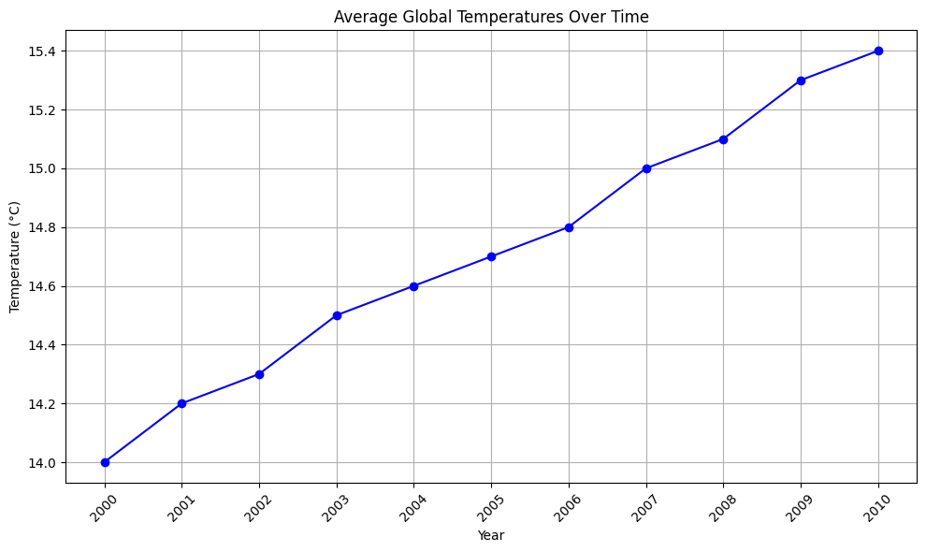
cont...

Slide 6
Social and economic disparities affecting various groups.
Key Issues
Income inequality
Education access
Racial and gender inequality

Slide 7
Technological Disruptions
Key Issues:
Automation and job displacement
Privacy concerns
Digital divide

Slide 8
Health Issues
Stigma and lack of resources
Impact of social media
Access to mental health care

Slide 9
Global Health Crises
Key Issues:
COVID-19 impact
Vaccine distribution
Future preparedness
with the help of WHO(World Health Organization)

Slide 10
Solutions and Strategies
Overview of Potential Solutions:
Climate action and sustainability
Reducing inequality through policy changes
Managing technological change and improving privacy
Enhancing mental health support and resources
Improving global health systems and preparedness

Slide 11
Conclusion
Successful climate initiatives
Innovations reducing inequality
Effective mental health programs

